Slide 1
AirSecureX: An AirDraw Authentication
TEAM MEMBERS:
ALBIN V JOHNSON
ALBIN THOMAS
NANDHANA PUSHPAN
Department Of Computer Application,
Saintgits College Of Engineering, Kottayam
SUPERVISOR:
ARYA R, AMRITHA PRIYA R
Assistant professor

Slide 2
CONTENTS
Introduction
Objectives
Solution Design And Architecture
Expected Output
Commercial Viability
Proposed Budget
Milestones
Conclusion

Slide 3

INTRODUCTION
01
Biometric authentication system using 3D figures
02
Convenient and user-friendly approach of unlocking a system
03
Implemented as a standalone device
Maintaining a high level of security
04

Slide 4

Target Customers
Healthcare Sector
Access Control in Restricted Areas
Touchless Authentication for Hygiene
Enhanced Patient Privacy
Cybersecurity Sector
Access Control & Fraud Prevention
Network Security & Identity Management
Banking Sector
Enhanced Fraud Prevention

Slide 5
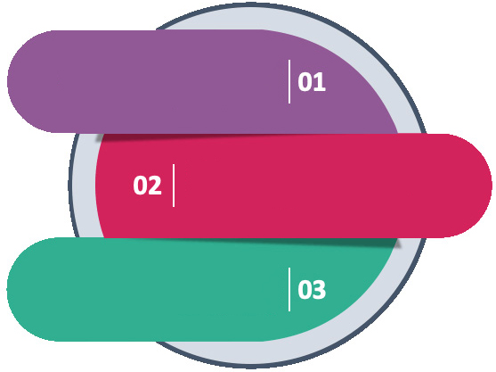
Objectives
Security Enhancement
Authentication Accuracy
Continuous Improvement
& Adaptation

Slide 6


Solution Design & Architecture
Measure & Prioritize
Research & Analysis
Implementation & Execution
Explore & Conceptualization
Prototype & Development
Design & Vision

Slide 7
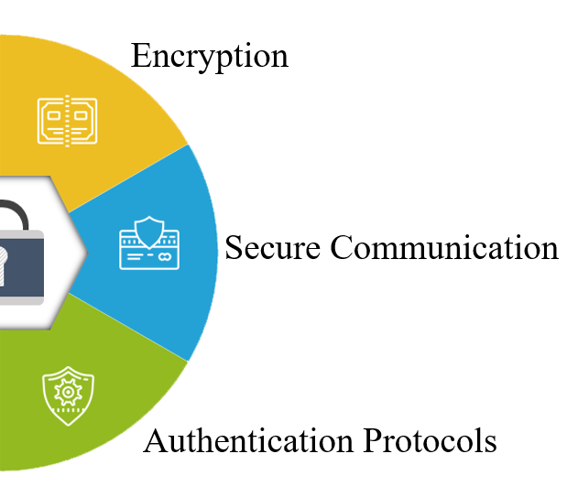
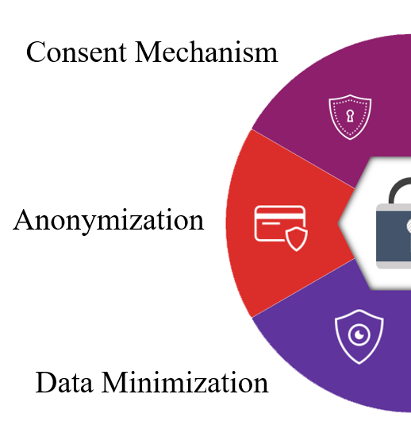
Security Features
Data Privacy Concerns

Slide 8

Expected Output

Slide 9
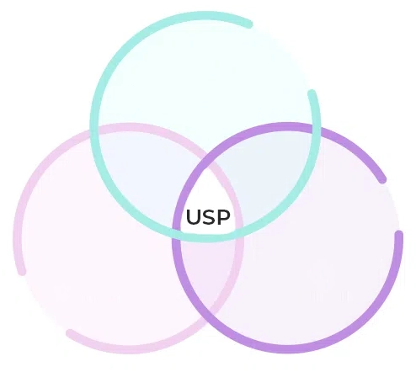
Commercial Viability
Scalability
Product USP
Unique Selling Proposition
Security
Non-Contact

Slide 10
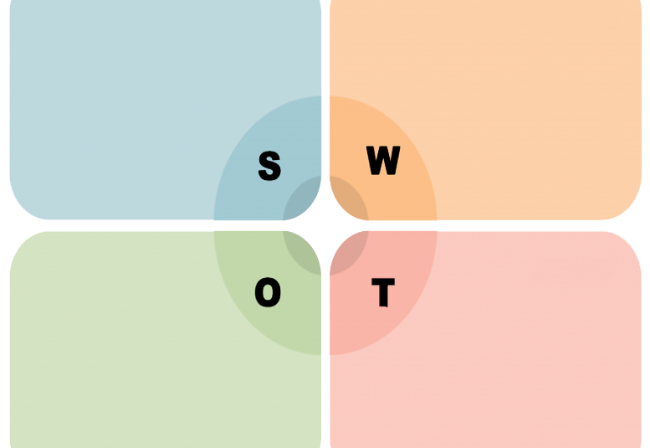
Swot analysis
Strengths
Weaknesses
High security
Non-contact authentication
Expensive
Spoofing concerns
Opportunities
Threats
Expansion into new markets
Versatile
Integration Potential
Competing technologies
Adaptability

Slide 11
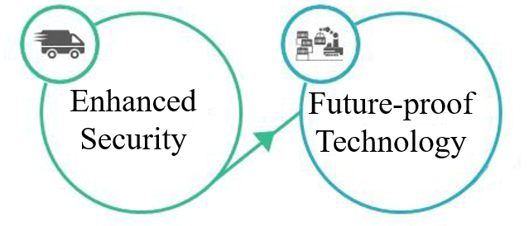


Demand in market

Slide 12
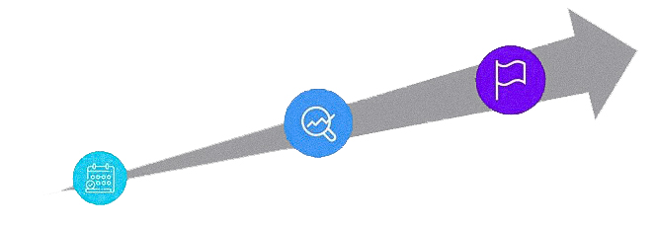
Gap analysis
Increased
Security
Fingerprint &
Facial Recognition
Touchless
authentication

Slide 13

Future scalability
Integration
Compatibility
Scalability

Slide 14


Milestones
2024
2024
2024 - 2025
1
2
3
Aug
Sept
Oct
Nov
Dec
Mar
System Preparation and Interface Development
Core Functionality and Security Implementation
System Optimization and Finishing

Slide 15

Milestone 1: System Preparation and Interface Development (August-September)
Hardware Selection
• Identify and procure suitable depth-sensing cameras
• Ensure compatibility with selected hardware interfaces
Software Framework Setup
• Set up the development environment for software & firmware
• Choose appropriate development tools and platforms
User Interface Design
• Design wireframes and prototypes for the user interface
• Develop the initial version of the user interface
Integration of Motion Capture Sensors
• Integrate selected depth-sensing cameras into the system.
• Implement initial software to capture & visualize 3D motion data

Slide 16

Milestone 2: Core Functionality and Security Implementation (October-November)
Motion Pattern Recognition Development
• Develop algorithms for capturing and analyzing 3D motion patterns
• Implement real-time processing of motion data to extract unique
features
Template Matching and Authentication
• Create a database for storing user-specific motion
• Implement template matching algorithms to compare captured
patterns with stored templates
Application Development
• Develop the application that will run on smartphones
• Integrate the motion capture and data processing modules with the
application

Slide 17
Milestone 3: System Optimization and Deployment (December-February)
Performance Optimization
• Optimize algorithms for efficiency and speed.
• Enhance system performance to ensure real-time processing
capabilities
User Experience Improvements
• Conduct user experience testing and gather feedback.
• Implement improvements based on user feedback to enhance
ease of use and acceptance rates.
System Launch
Conduct final testing to ensure all components are working seamlessly
After the successful implementation and testing, launch the system officially.
.

Slide 18
Gesture Registration System
Workflow Overview
Leap Motion Setup and Gesture Capture
Data Processing and Augmentation
Autoencoder Model Building and Training
Threshold Calculation
GUI for Gesture Registration

Slide 19
Gesture Unlock System
Workflow Overview
System Initialization
Monitoring Protected Application (Process Watchdog)
Authentication Prompt and Gesture Capture
Data Preprocessing
Gesture Verification using Autoencoders
Threshold Comparison

Slide 20
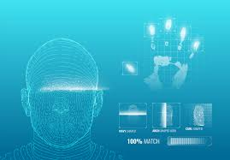
Conclusion
3D Motion Patterns: Utilizes 3D motion patterns for user identification.
Security Enhancement: Offers increased security compared to traditional methods.
Convenience: Provides a convenient alternative to conventional authentication processes.
Unique Gestures Analysis: Analyzes unique gestures and movements during the creation of 3D figures for accurate user identification.
Implementation Flexibility: Can be deployed either as a standalone device or integrated into mobile phones.
Research and Development: Requires extensive research, experimentation, and user testing to develop accurate algorithms and ensure usability and effectiveness.
Revolutionary Potential: Holds the potential to revolutionize device unlocking through the introduction of a secure authentication method.

Slide 21


Slide 22

Any Questions

